Slide 1

Install Ubuntu
SOFTWARE ENGINEERING

Slide 2
Contents
Dual Boot
Virtual Machine

Slide 3
DUAL BOOT
Download Ubuntu: https://ubuntu.com/download/desktop
Download the .iso file
Create a Boot USB
MAKE SURE THE USB DOESN’T CONTAIN ANYTHING IMPORTANT AS IT WILL BE WIPED COMPLETELY
Link: https://www.youtube.com/watch?v=mXyN1aJYefc

Slide 4
Create a Boot USB
Once you have downloaded the Ubuntu ISO, you need to create a USB for the Boot of Ubuntu at the startup of your PC. To do so, you will need another tool called Rufus, and once downloaded you can run the executable.
Download Rufus: https://rufus.ie/en/
Put the USB on your PC and in the section "Boot Selection" insert the directory of your PC where you downloaded the Ubuntu ISO in the previous step.

Slide 5
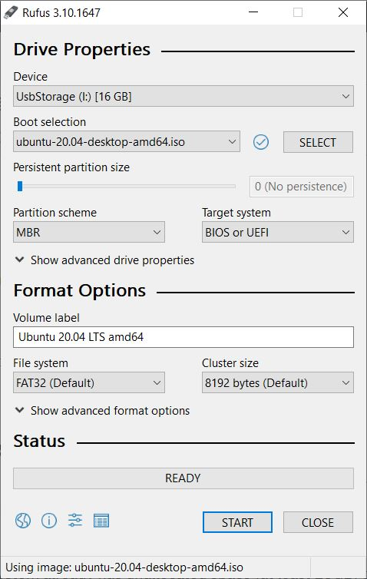
Once done with the configuration of Rufus, click on "Start" and wait until the program finishes the writing process of the ISO on the USB.

Slide 6
Preparing Windows for the Dual Boot
Before installing Ubuntu, you need to reserve some space on your Hard Disk to be used by Ubuntu. I would suggest you reserve at least 30GB to install Ubuntu and all the additional components needed in this course.
To create a partition in Windows click on Win + R and then diskmgmt.msc and click on "OK".
This will show you the storage space available on your PC and you will be able to create partitions of the disk and reserve space for other operating systems on the same computer.

Slide 7
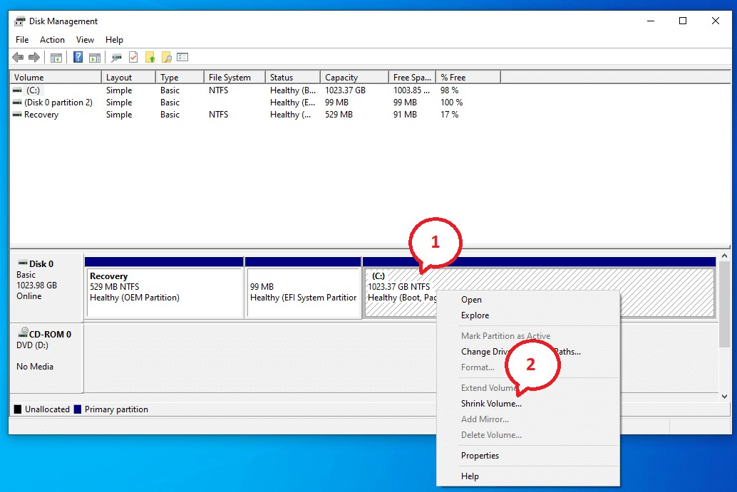
Then specify the size to be reserved for Ubuntu and once done click on "Shrink"

Slide 8
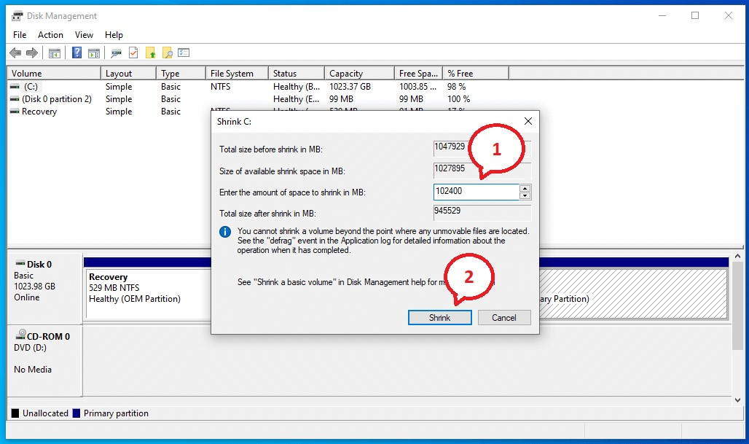
This will create a partition of your hard disk of the specified size

Slide 9
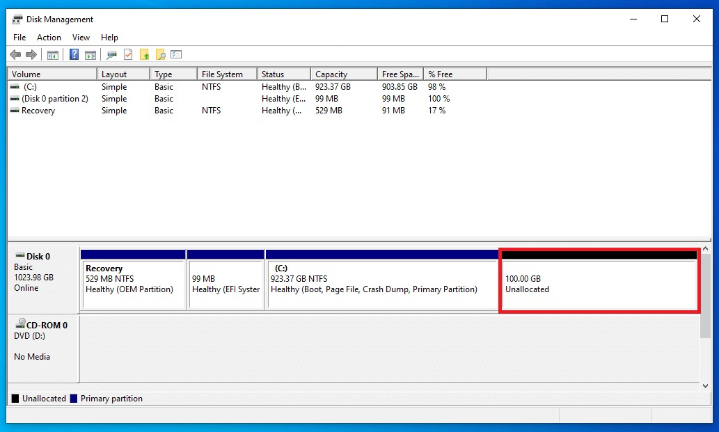
At this point, you are ready to install Ubuntu and all the components in this reserved area of the hard disk.

Slide 10
Installing Ubuntu
Plug the USB in your PC on which you installed Ubuntu and reboot your PC in advanced mode by clicking on "Advanced Startup". To do so, go in Windows settings and then "Update & Security“
Then go in the "Recovery" tab and click on "Advanced Startup" and then on "Restart Now“
Windows will reboot in advanced mode and will ask you which action to take. Here click on "Use a device" to reboot your PC with the Ubuntu Boot installed in the USB.

Slide 11
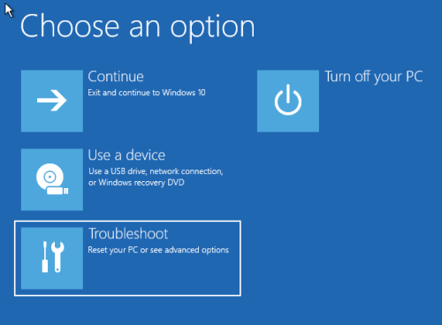
On the next startup of the PC, it will booted with the operating system ion the USB and you can start installing Ubuntu

Slide 12
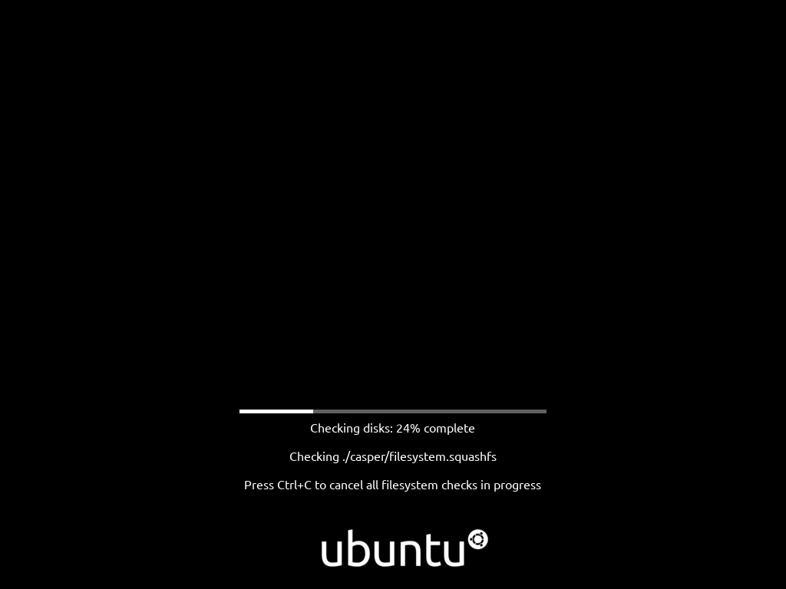

Slide 13
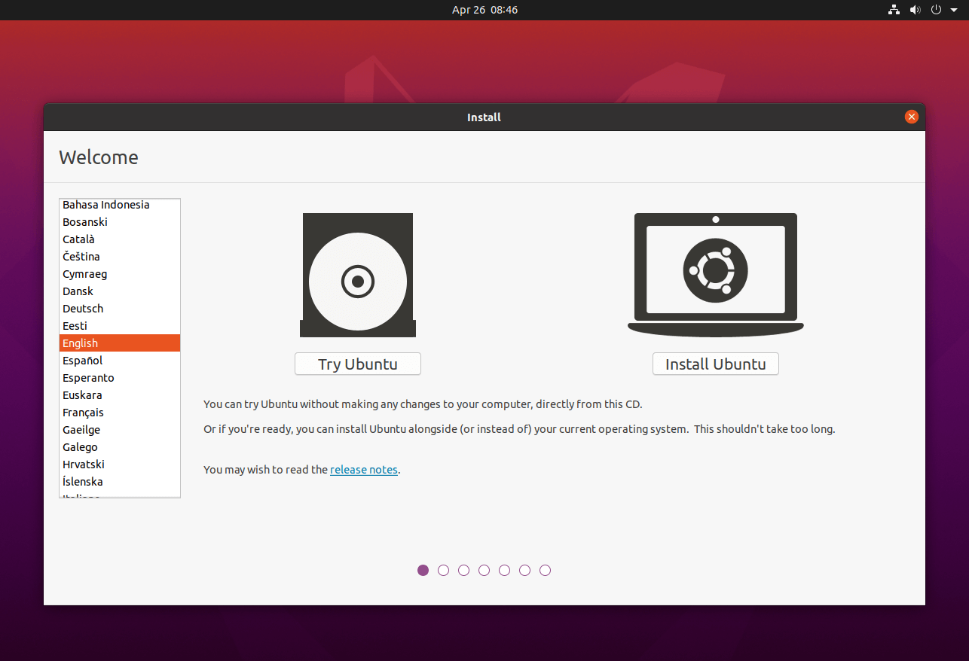
In the Ubuntu welcome window select "Install Ubuntu"

Slide 14
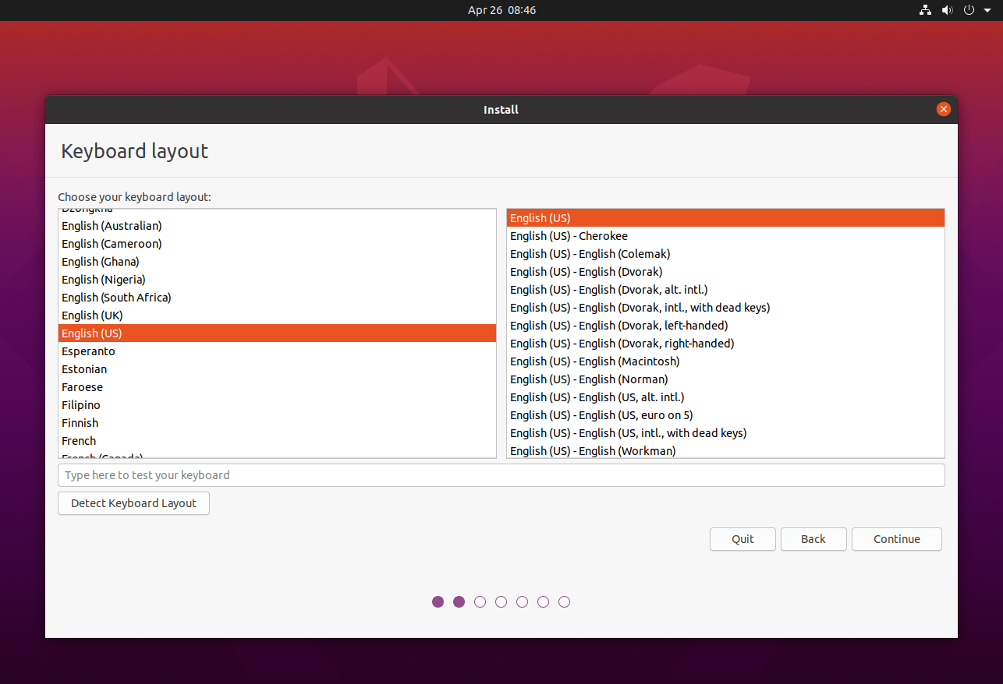
Then choose the configuration of your keyboard and click on "Continue"

Slide 15
In the following window, you will be asked which kind of installation you want to execute. In order to have the full version of Ubuntu with all the components click on "Normal Installation" and during this phase you will be asked also to download automatically the Ubuntu updates during the installation of the operating system. Also, you can choose to download and install third-party software like for example the drivers of your graphics card.
I would suggest you at least to select the voice "Download updates while installing Ubuntu" and then click on "Continue"

Slide 16
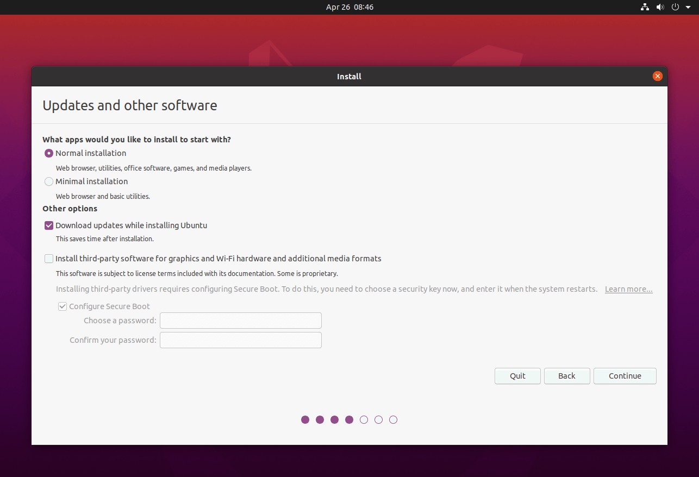

Slide 17
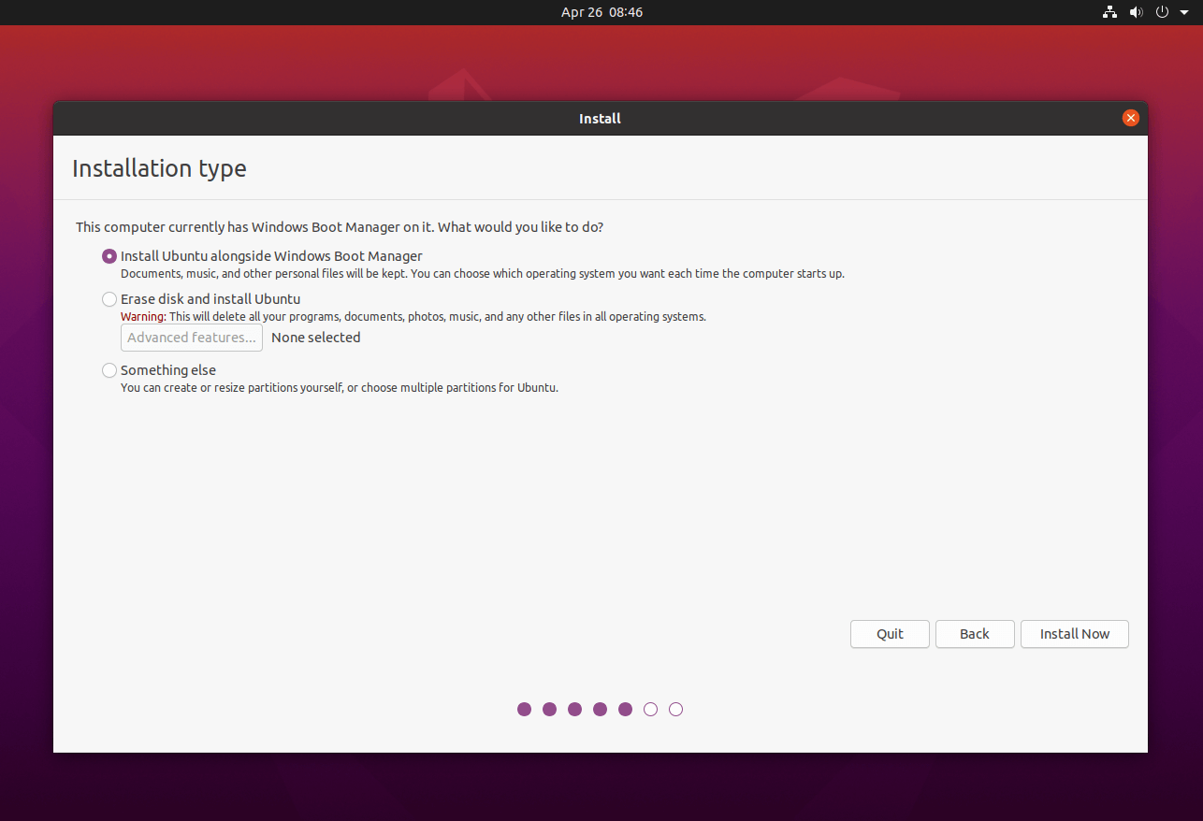
Finally, before proceeding with the installation of Ubuntu, you will be asked in which storage space you want to install all the components. The system will automatically be able to identify that a version of Windows is already installed on your PC and then the "Install Ubuntu alongside Windows Boot Manager" option will appear and click on "Install Now".

Slide 18
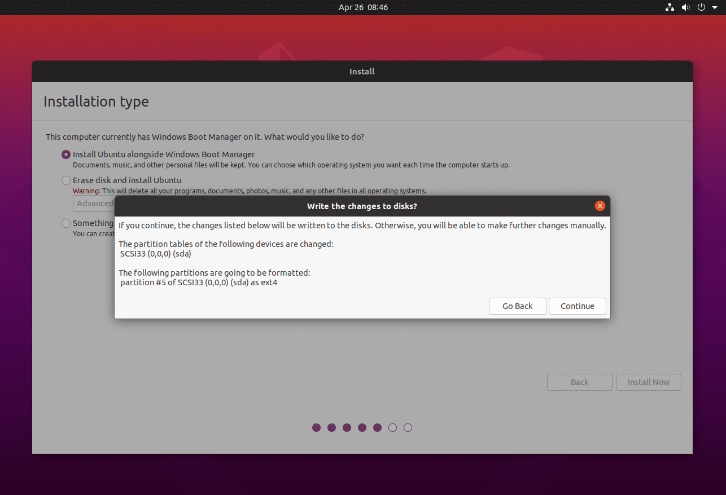
Select "Continue" to allow the installation procedure to automatically create the partition for the installation of the Ubuntu Boot side by side with the Windows Boot so the at the startup of your PC you can select which operating system to use.

Slide 19
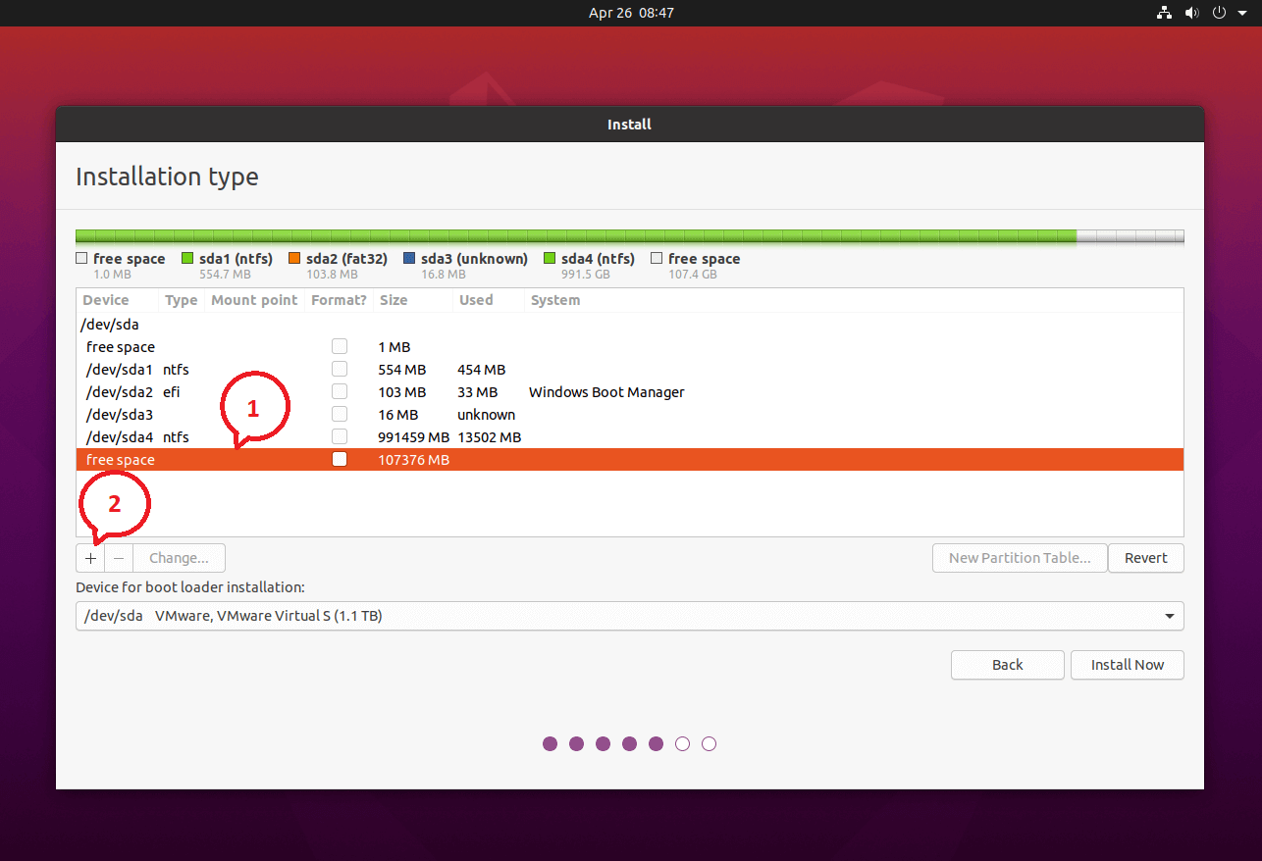
Now it is possible to choose the partition of your operating system in which to install Ubuntu and to do so, select the partition of your disk that you created in the previous steps. With this partition selected, click on "+"

Slide 20
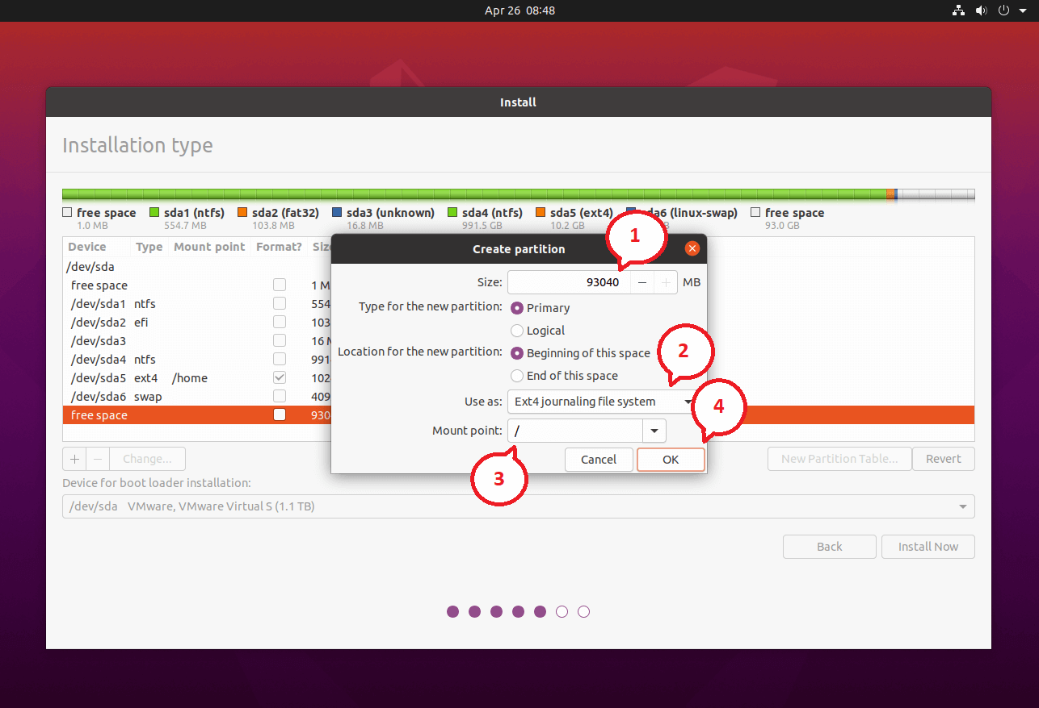
Fill the field "Size" with the size available in the partition and in the dropdown menu called "Use as" select "Ext4" and as "Mount Point" select the root with "/"

Slide 21
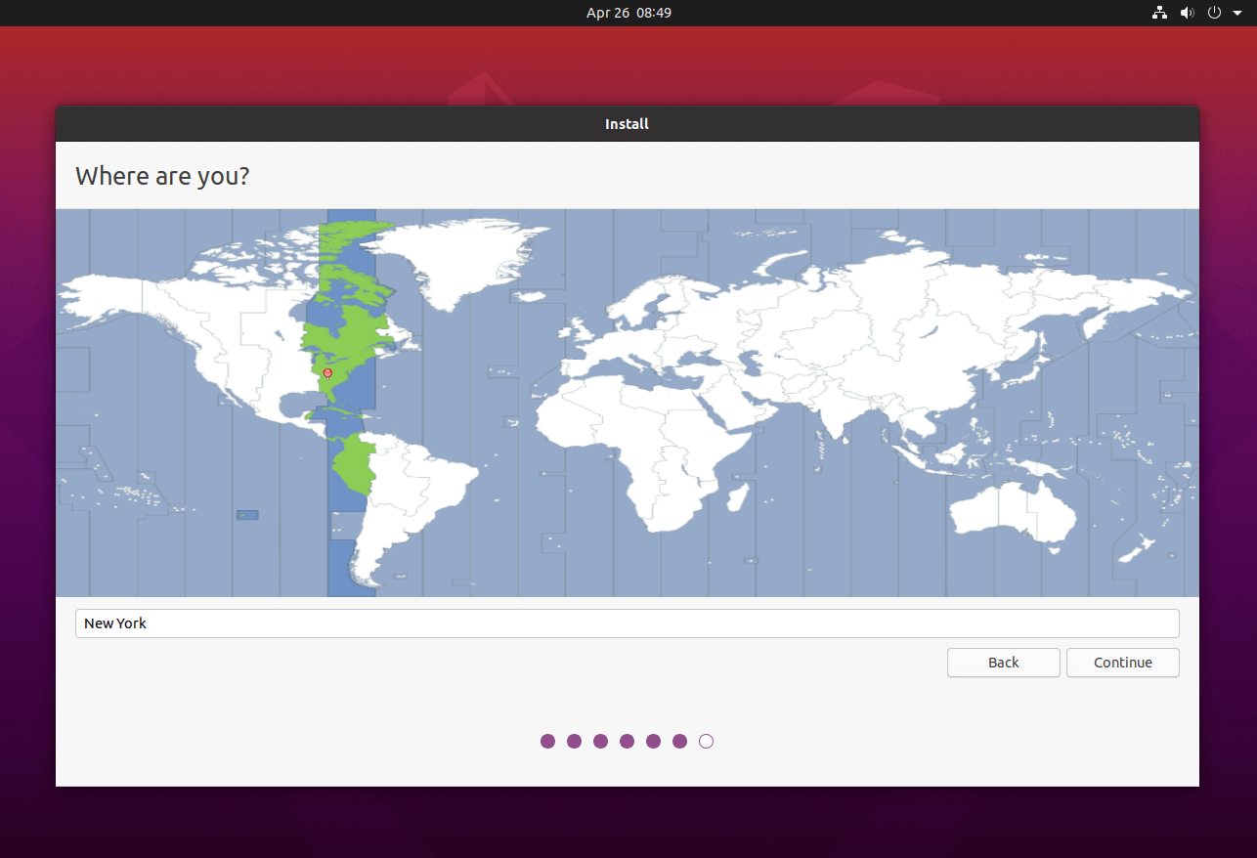
The configuration of the installation is completed and now the system will start to install Ubuntu in the partition of your hard disk.
During the installation procedure, you can configure further information about Ubuntu such as the timezone and your username and password to access Ubuntu.

Slide 22
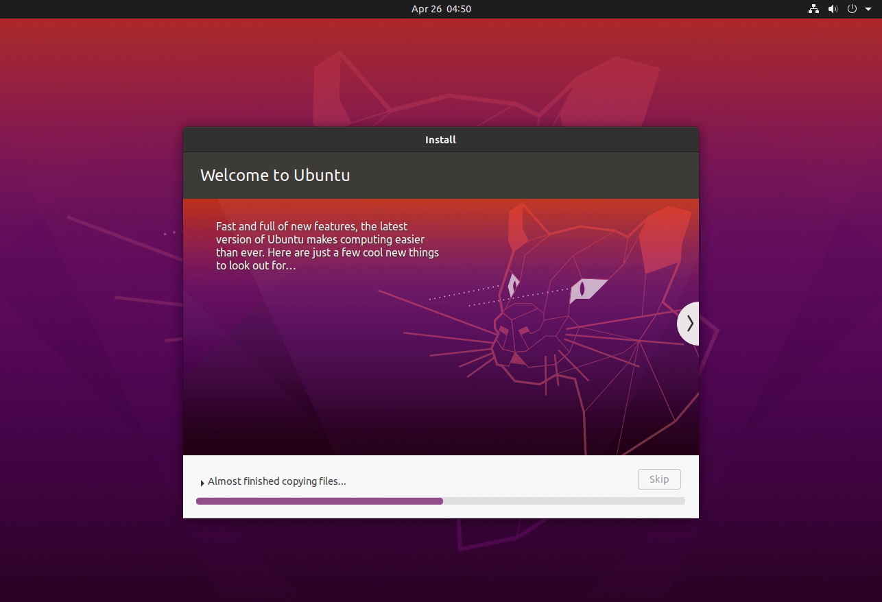

Slide 23
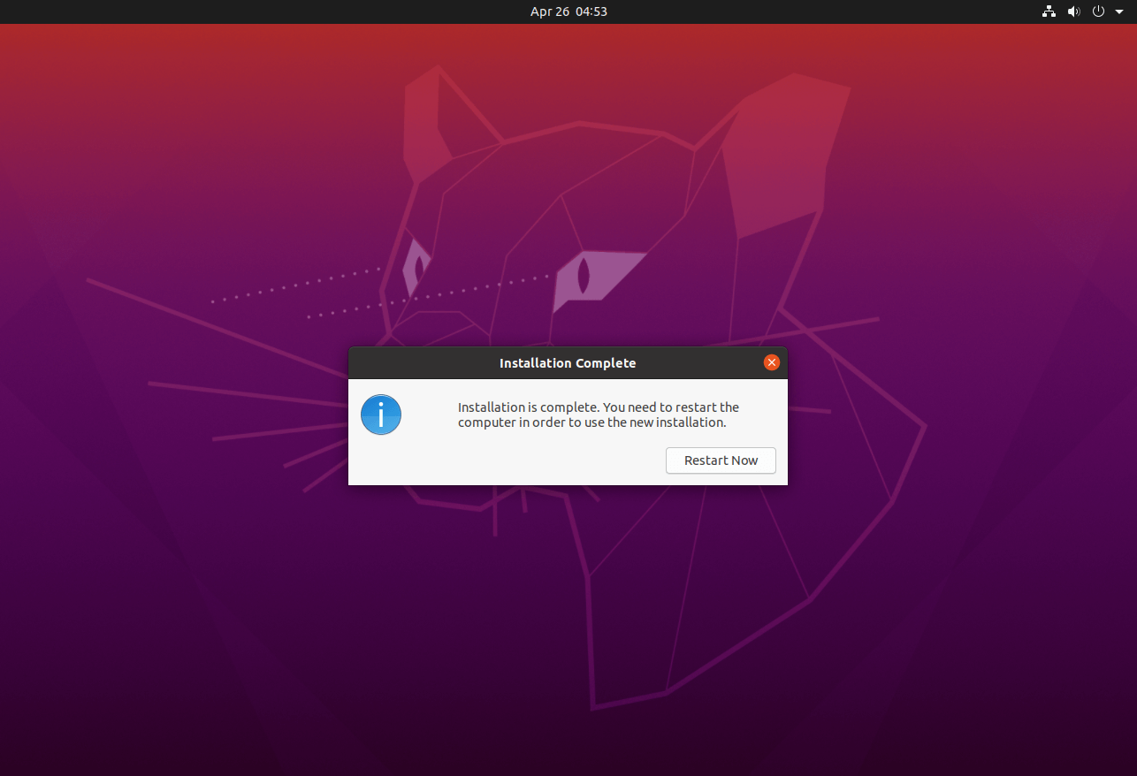
Reboot your PC by clicking on "Restart Now"

Slide 24
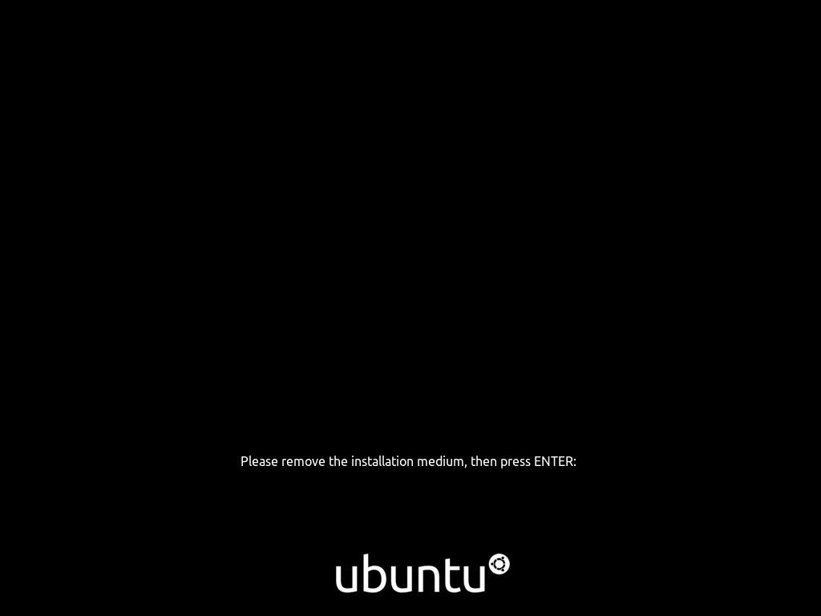
At this point unplug the USB with the Ubuntu Boot and click on Enter on your keyboard

Slide 25
Virtual Machine
Download Ubuntu: https://ubuntu.com/download/desktop
Download the .iso file
Link: https://www.youtube.com/watch?v=-CIepTSsaNE
Download VirtualBox Windows host: https://www.virtualbox.org/wiki/Downloads
IMPORTANT: ENABLE VIRTUALIZATION ON YOUR PC FROM BIOS

Slide 26
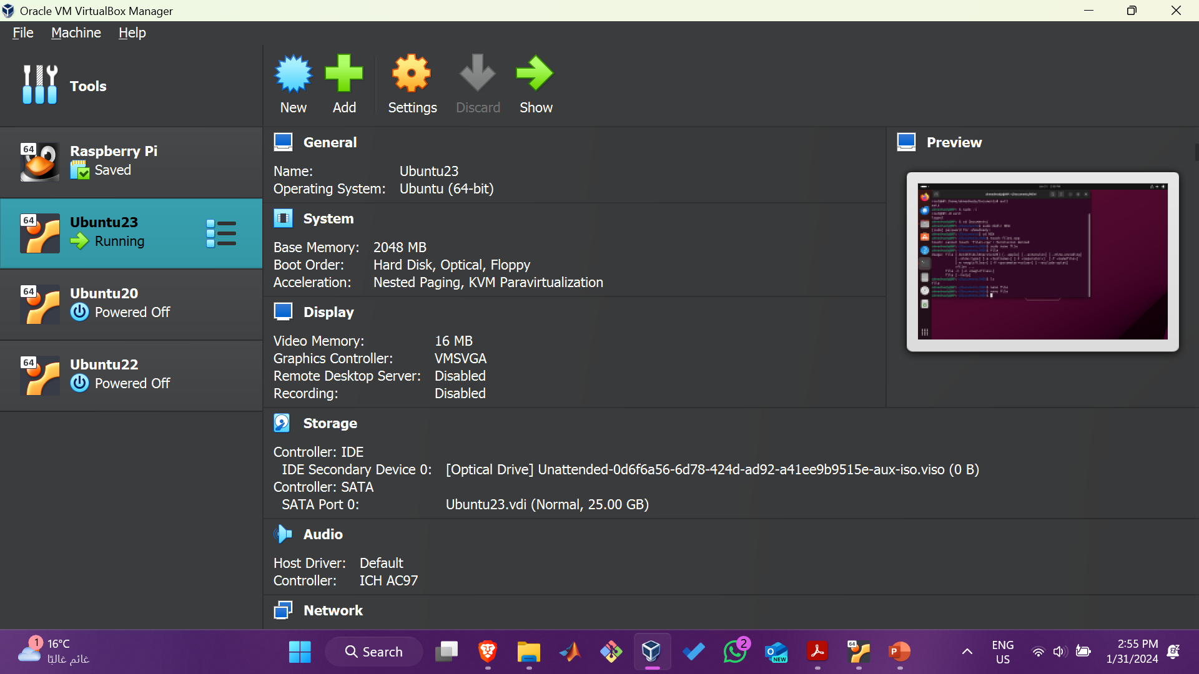

Slide 27
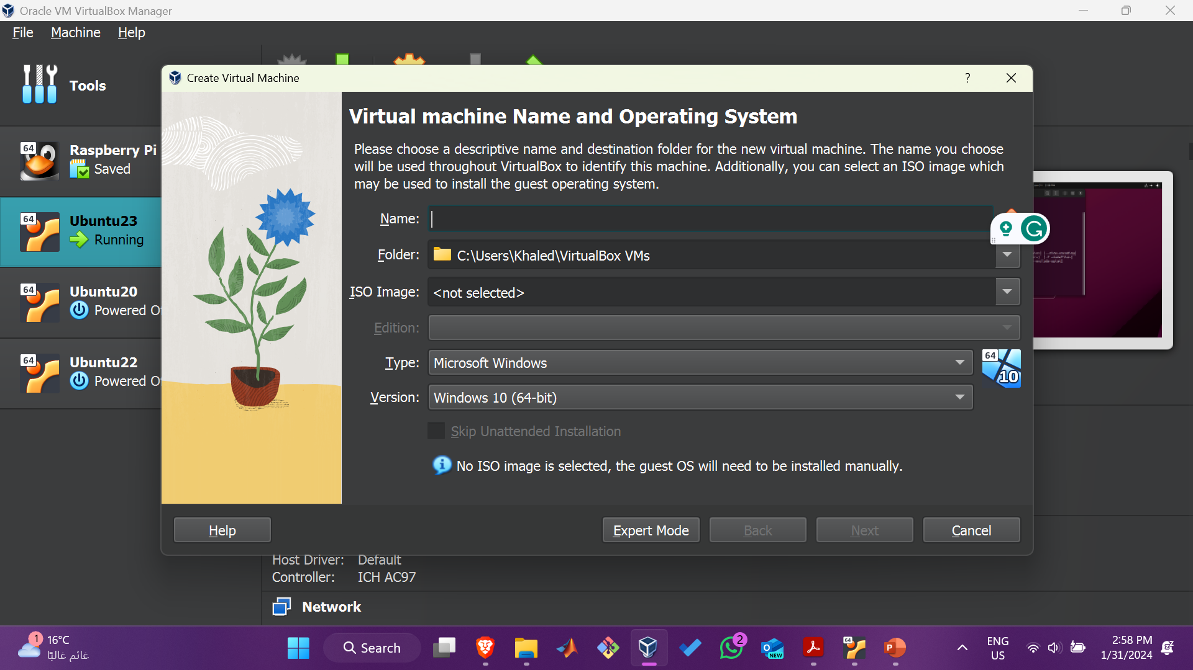
Click 'New' button to open a dialog

Slide 28
Type a name for the new virtual machine. Example: ‘Ubuntu22'. Note that VirtualBox automatically changes 'Type' to Linux and 'Version' to 'Ubuntu (64 bit)'. These two options are exactly what we need.

Slide 29
The memory size depends on your host machine memory size. In my case, I have 12GB physical RAM. I like to allocate as much as possible for Ubuntu but leave some for my Windows host machine. I pick 8192 MB for my Ubuntu. Note that VirtualBox will create a swap partition with the same amount space as base memeory you have entered here. So later when you are selecting the size of the virtual hard drive, make sure it is large enough since the hard drive will be splitted into root (/)and swap partitions. The root partition contains by default all your system files, program settings and documents.

Slide 30
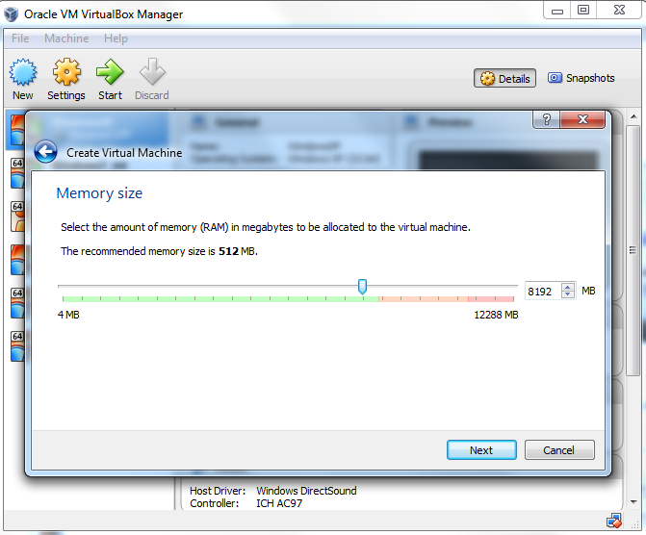

Slide 31
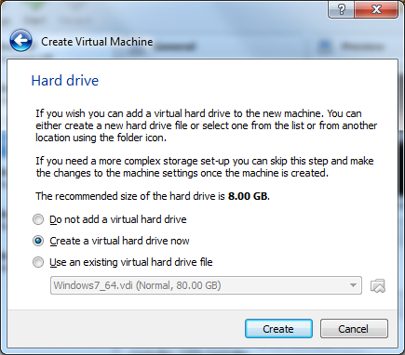
Accept the default 'Create a virtual hard drive now' and click 'Create' button.

Slide 32
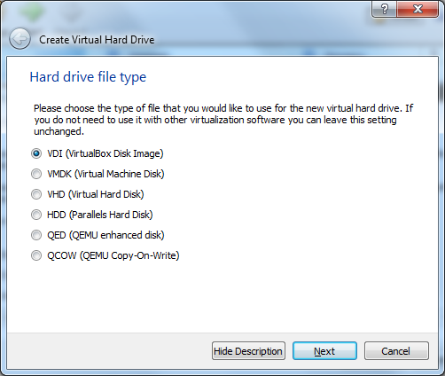
Continue to accept the default 'VDI' drive file type and click 'Next' button.

Slide 33
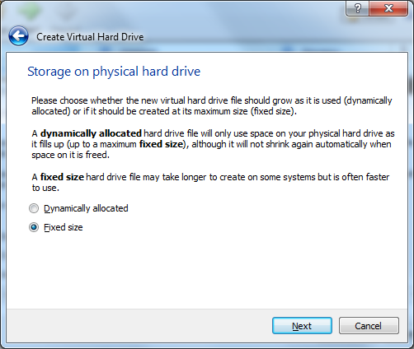
Change the storage type from the default 'Dynamically allocated' to 'Fixed size' to increase performance.

Slide 34
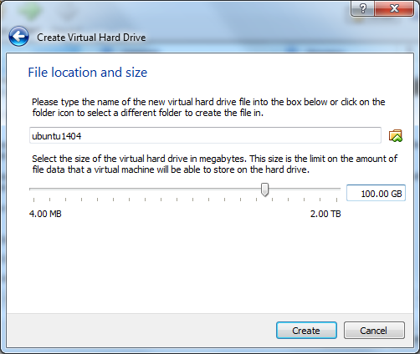
Click 'Create' button and VirtualBox will generate Ubuntu virtual machine.

Slide 35
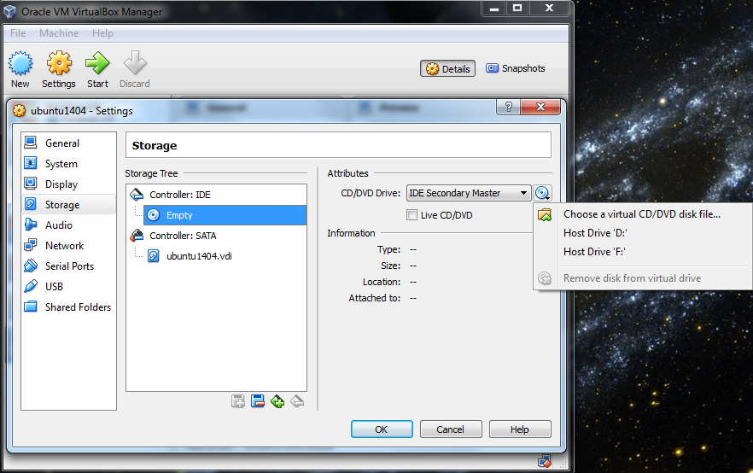
Now the virtual machine is created. We are ready to install Ubuntu in this virtual machine. Select your new virtual machine and click 'Settings' button. Click on 'Storage' category and then 'Empty' under Controller:IDE. Click "CD/DVD" icon on right hand side and select the ubuntu ISO file to mount.

Slide 36
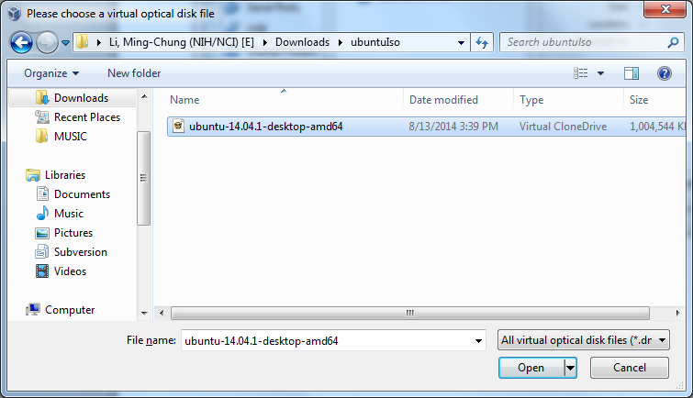

Slide 37
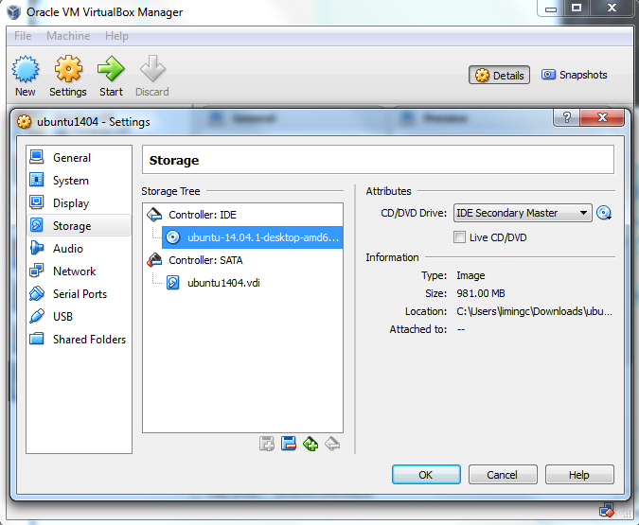

Slide 38
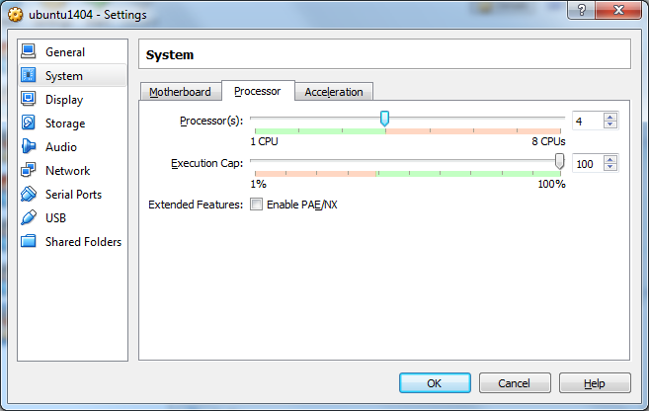
it is a good idea to specify a large number of processors in virtual machine (default value is 1). You can change this number by clicking on 'System' category. Choose 2 or 3 or 4. Now you can click 'OK' button to continue.

Slide 39
Install Ubuntu
Back to Oracle VM VirtualBox Manager, click on the new Ubuntu virtual machine and hit 'Start' button. Now you shall see a 'Welcome' screen. Click 'Install Ubuntu' button. Note that the installation process may differ a little bit from version to version.

Slide 40
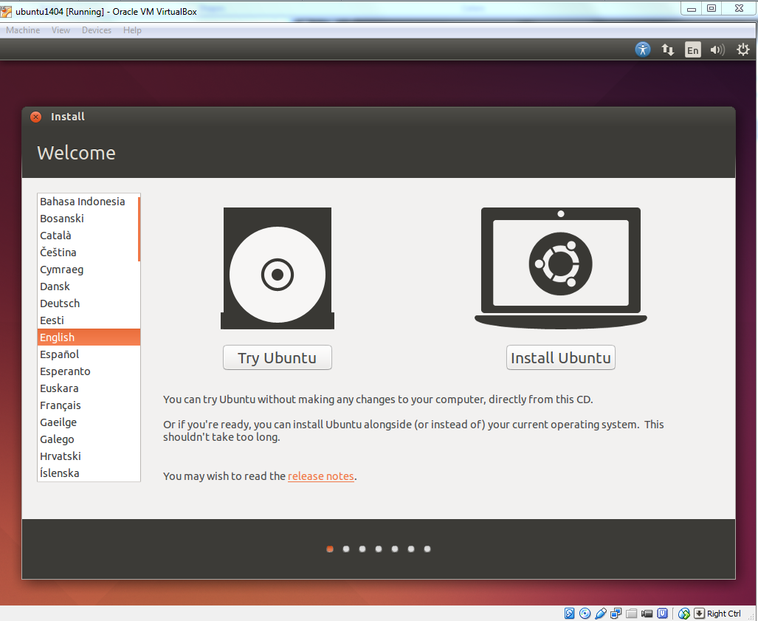

Slide 41
THE REMAINING STEPS ARE THE SAME AS FROM SLIDES 13 TO 24

